Slide 1
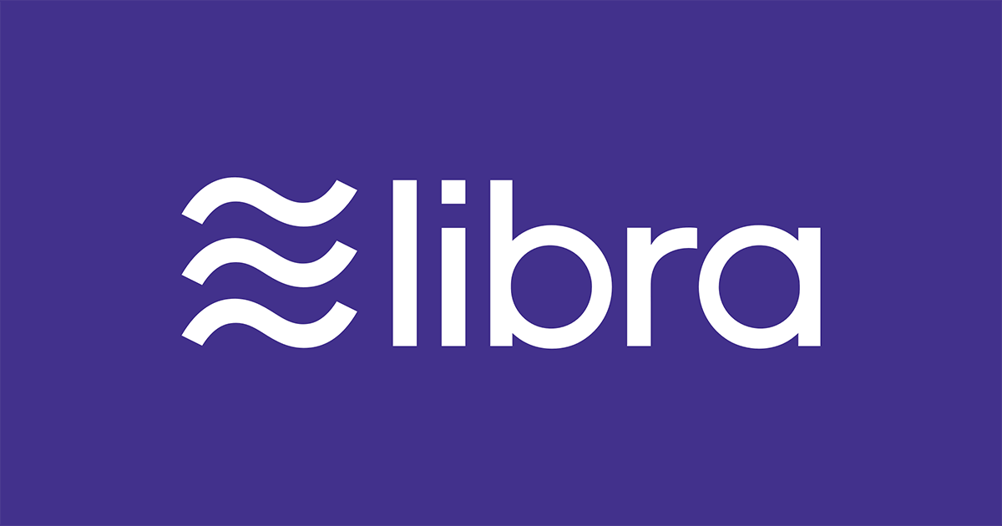

Slide 2
What is it?
A new payment network from scratch, complete with its own currency

Slide 3
What is it for?
Buy things
Send money
Nearly zero fees
Global
Accessible to unbanked
Pseudo private
Decentralized

Slide 4
How do you get, store, use, cash out?
Online
Local exchanges (e.g. grocery stores)
Third party wallet
Calibra wallet, FB
WhatsApp, FB
Messenger, FB
Facebook
Partners

Slide 5
If more commerce happens, then more small businesses will sell more on and off platform, and they’ll want to buy more ads on the platform so it will be good for our ads business.
David Marcus, Facebook’s VP of blockchain

Slide 6
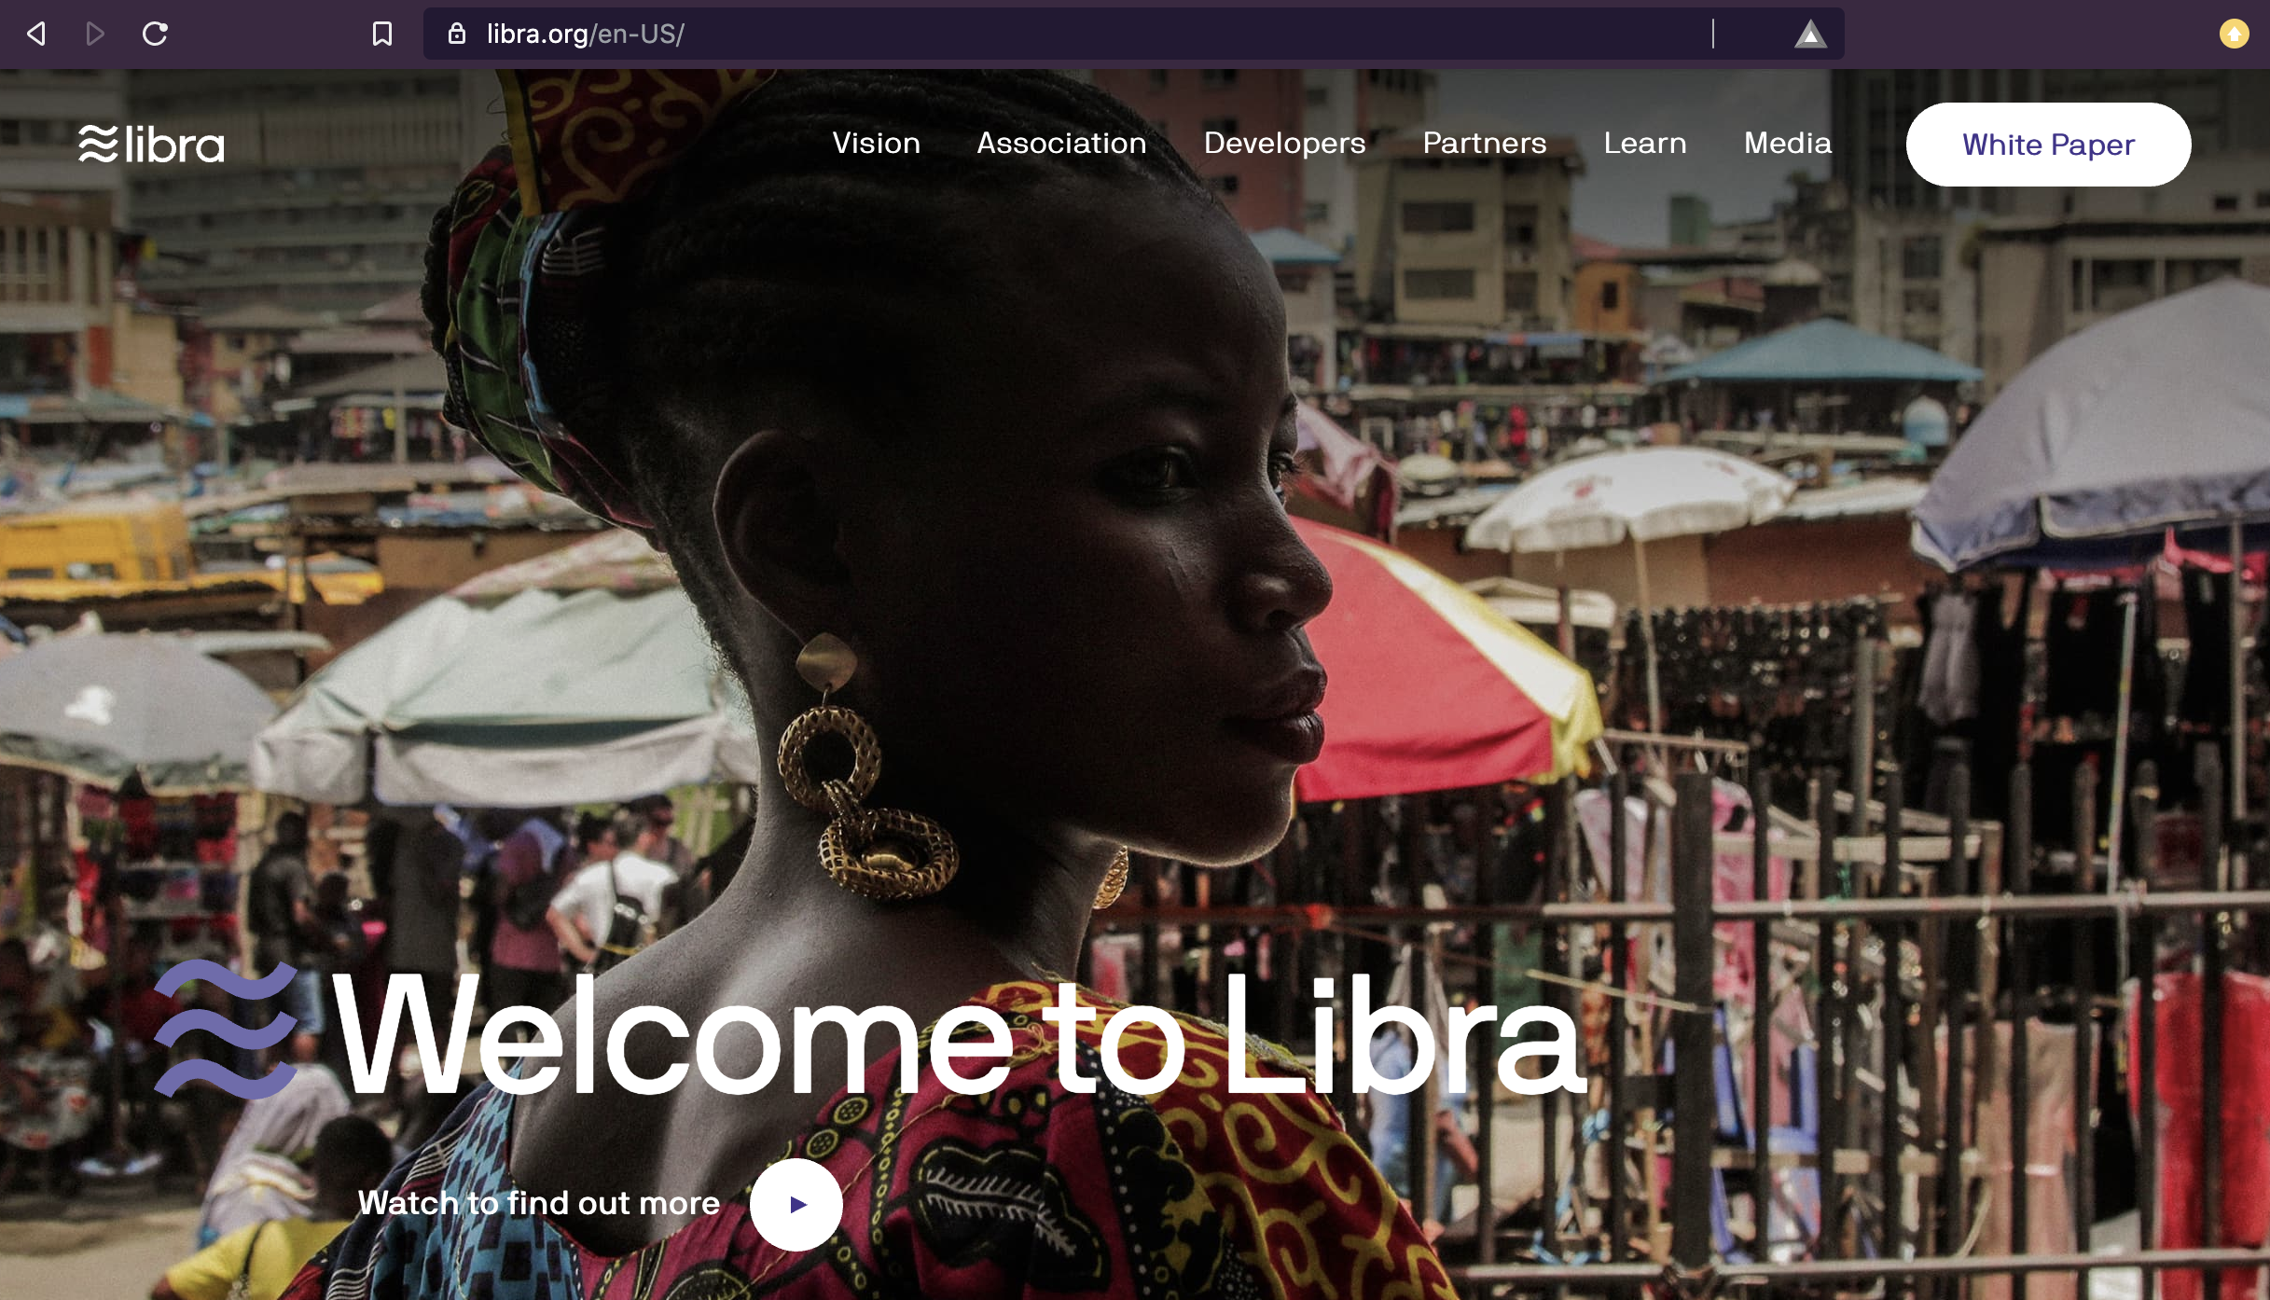

Slide 7


Opportunity

Slide 8
Disruption
Realization of blockchain dream
Disrupt how things are bought and sold
No trusted intermediaries
No fees – or lower fees
Real time – near real time

Slide 9
Unbanked
1.7 Billion
It is too expensive to be poor
Everything costs more

Slide 10
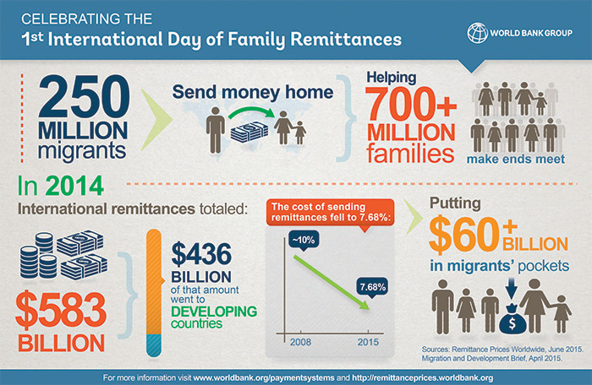

Slide 11
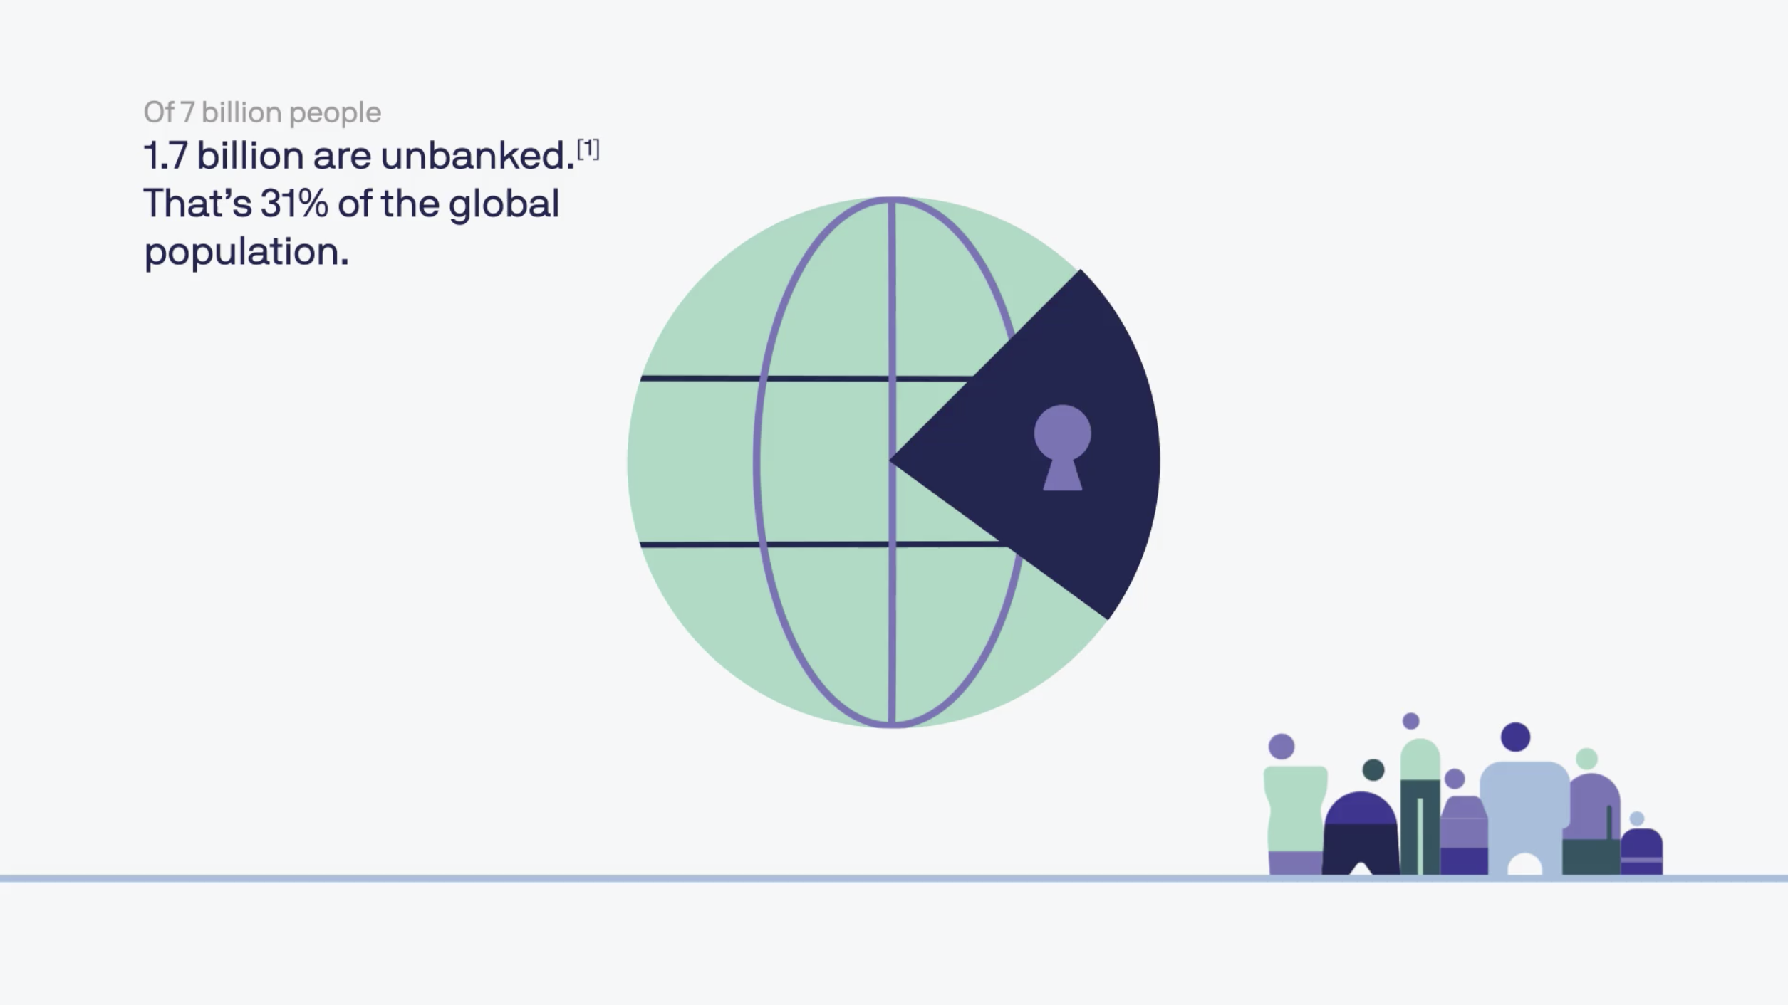

Slide 12
Bitcoin & Ethereum are for nerds
What’s a hash
What’s block
What do you mean I need a key pair?
No customer service

Slide 13
Scalability challenges of public blockchain
~7 transactions per second
Volatility
Acceptance of cryptocurrency
Difficult to use

Slide 14
FB’s ecosystem
7 million advertisers
90 million small businesses
2.5 billion people on FB apps
Facebook, Instagram, WhatsApp, Messenger
15 years experience delivering apps

Slide 15
Goal
Global payment method
More efficient - faster
Fewer fees
Accessible to unbanked
Programmable money
More stable through decentralization.

Slide 16
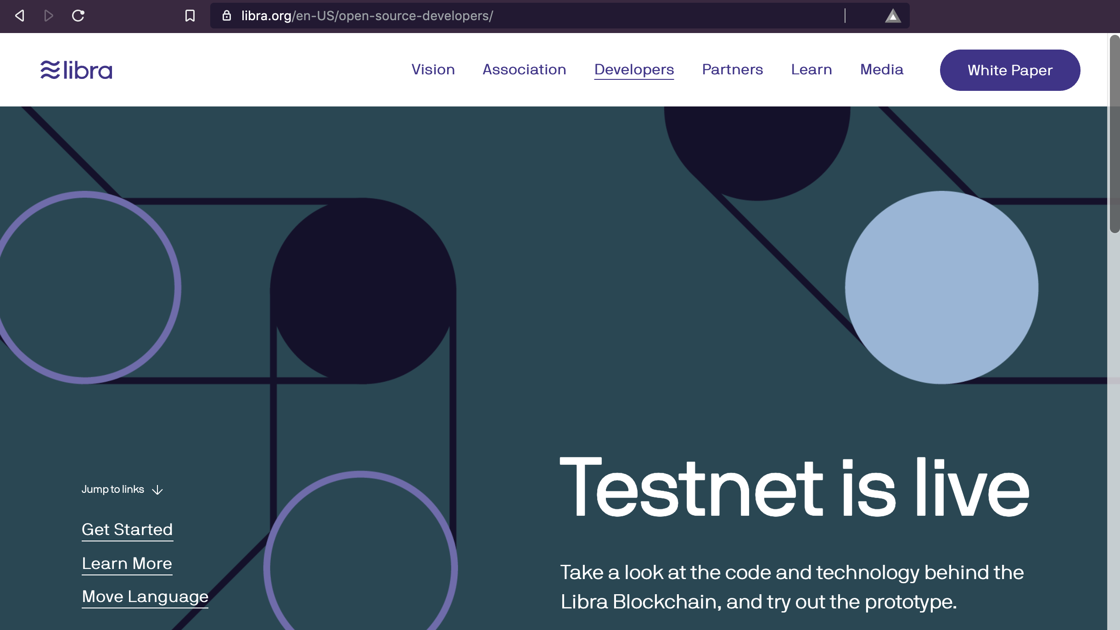

Slide 17

Libra Foundation

Slide 18
If we were controlling it, very few people would want to jump on and make it theirs
David Marcus, Facebook’s VP of blockchain

Slide 19
Libra Foundation
Facebook gets one vote
Other votes go to founding members
Members pay $10 M to join
Foundation:
Open source Libra Blockchain
Developer platform
Move programming language
Signs up business to libra
Customer discounts, rewards

Slide 20
Members
$10 M to join
1 vote on Libra Association Council
Larger of 1 vote or 1% of total vote
Share interest – proportional to investment
Architected for decentralization
Permissioned blockchain
The club model

Slide 21
Membership Requirements
100 Mbps dedicated internet connection
Half a rack of server space
Full time engineer
Secure infrastructure
Market value: over $1 billion
Scale: reach 20+ million people/year globally
Brand: Top-100 industry leader
Different criteria for non-profits, universities

Slide 22
28 founding members
Payments: Mastercard, PayPal, PayU (Naspers’ fintech arm), Stripe, Visa
Technology and marketplaces: Booking Holdings, eBay, Facebook/Calibra, Farfetch, Lyft, Mercado Pago, Spotify AB, Uber Technologies, Inc.
Telecommunications: Iliad, Vodafone Group
Blockchain: Anchorage, Bison Trails, Coinbase, Inc., Xapo Holdings Limited
Venture Capital: Andreessen Horowitz, Breakthrough Initiatives, Ribbit Capital, Thrive Capital, Union Square Ventures
Nonprofit and multilateral organizations, and academic institutions: Creative Destruction Lab, Kiva, Mercy Corps, Women’s World Banking

Slide 23
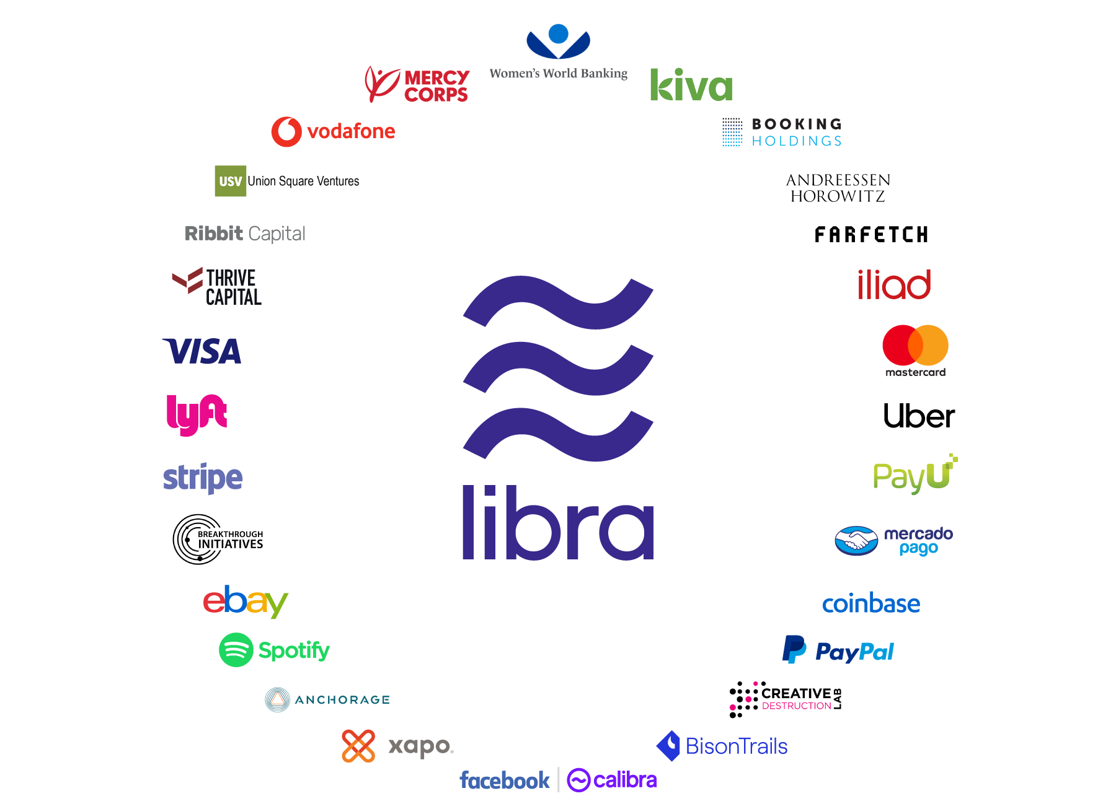

Slide 24
100 founding members - target
$1 Billion

Slide 25
Switzerland
The libra association is based on Geneva, Switzerland
Swiss Financial Market Supervisory Authority, FINMA
Clarity on blockchain technology regulation

Slide 26
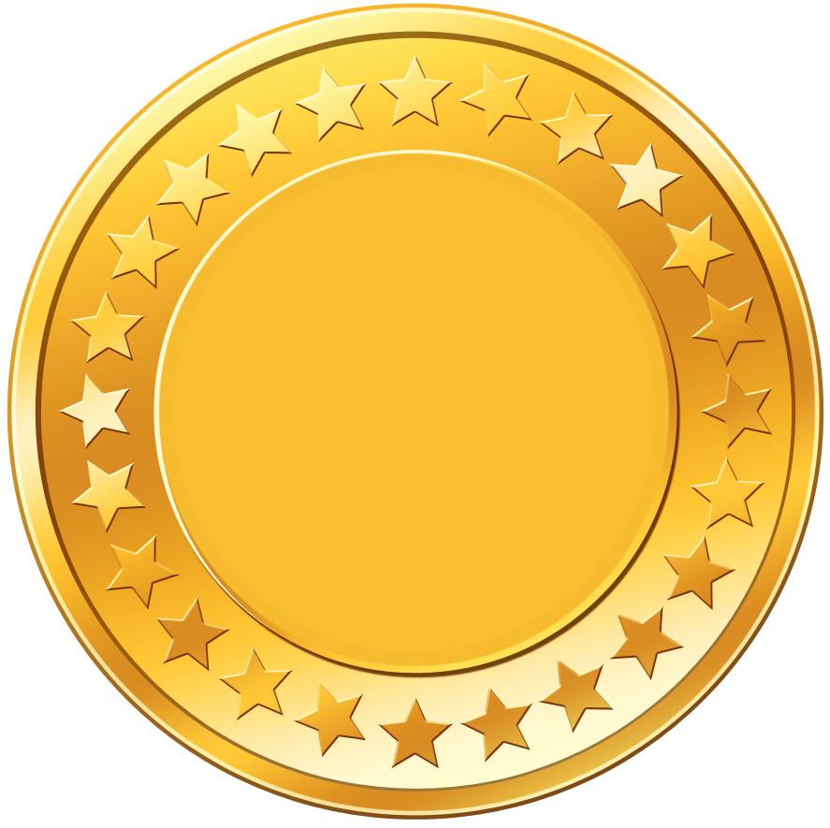

Libra Currency

Slide 27
Stablecoin Goals
Stability
Tied to a basket of:
Bank deposits
Short-term government securities
Currencies
Dollar
Pound
Euro
Swiss franc
Yen
Composition can change to offset fluctuations

Slide 28

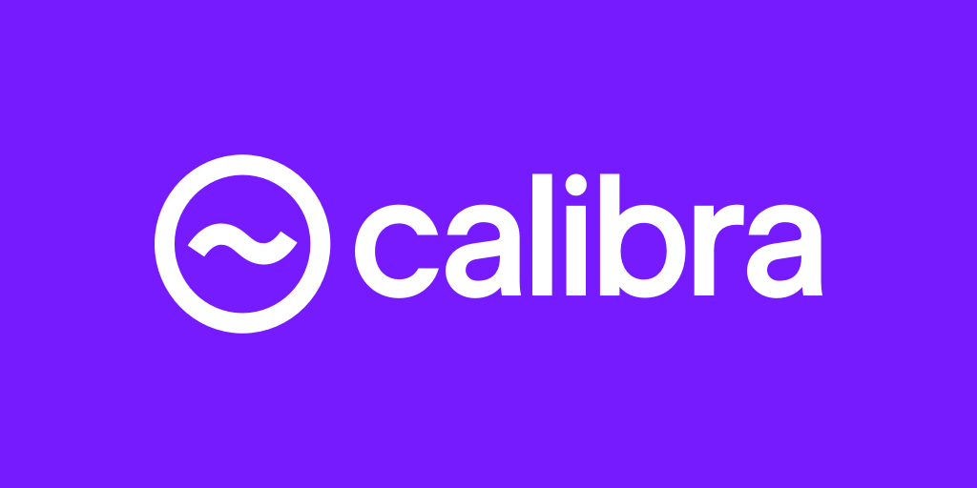
3rd party apps
Local resellers

Slide 29

Libra Purchase
Cash Out

Slide 30
One for One

Slide 32
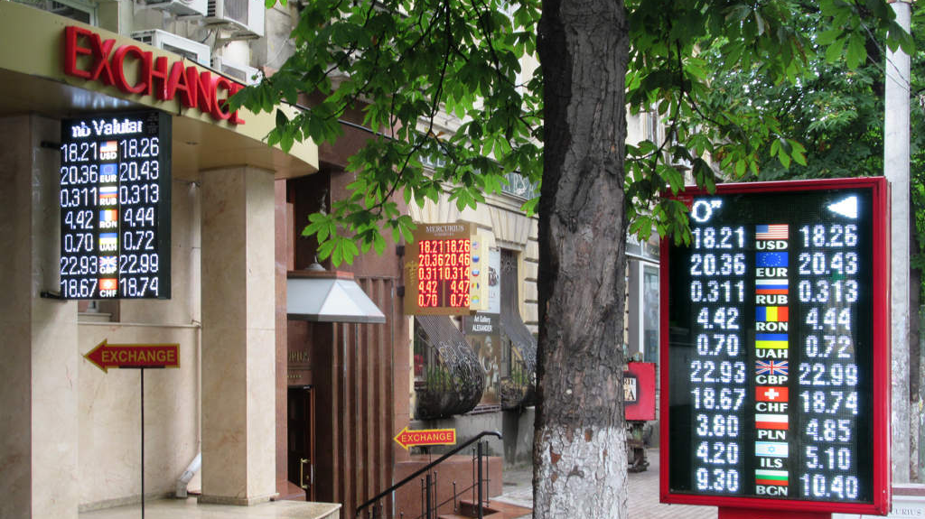

Slide 33
Get Libra

Slide 34
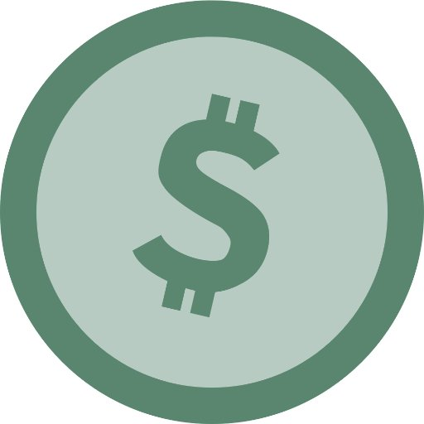
v

Slide 36

CREATE

Slide 37
CREATE

Slide 39
Cash Out

Slide 40
v

Slide 43

DESTROY

Slide 46
100% in Reserve
Never runs fractional

Slide 47
Reserve
Dollar
Pound
Euro
Swiss franc
Yen
Short-term government securities

Slide 48

Libra Performance

Slide 49
Public Blockchains
Bitcoin, 7 transactions per second
Ethereum, 15 transactions per second

Slide 50
Libra
1,000 transactions per second
5 kb transactions
1,000 verifications per second
4 billion accounts
40 mpbs
16 TB SSD hard drives
Permissioned by design

Slide 51
Safety Precautions
If over 1/3 of nodes compromised, system halts
Transactions costs are low, fraction of a cent
Large scale spam would add up – deter DOS

Slide 52
Proof-of-stake
Not proof-of-work

Slide 53
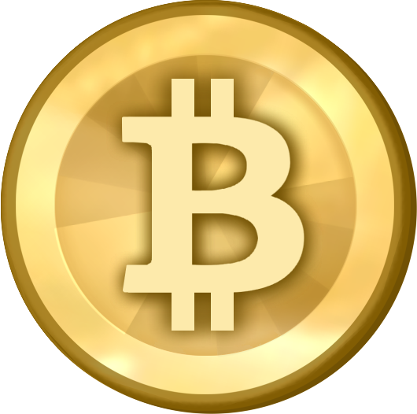

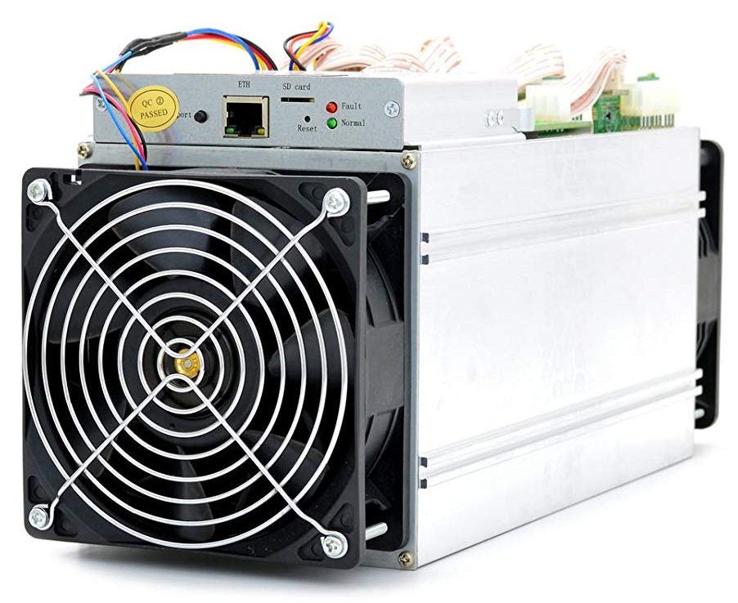


Rewards
Purchase
Miner
Puzzle Solutions

Slide 54
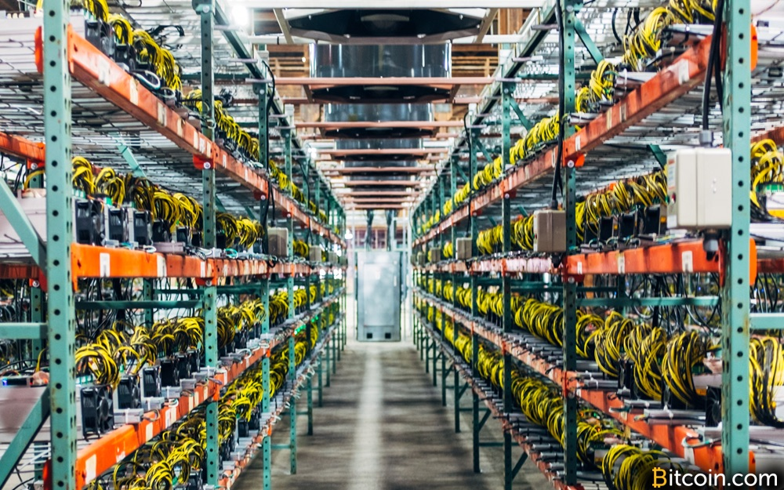

Slide 55
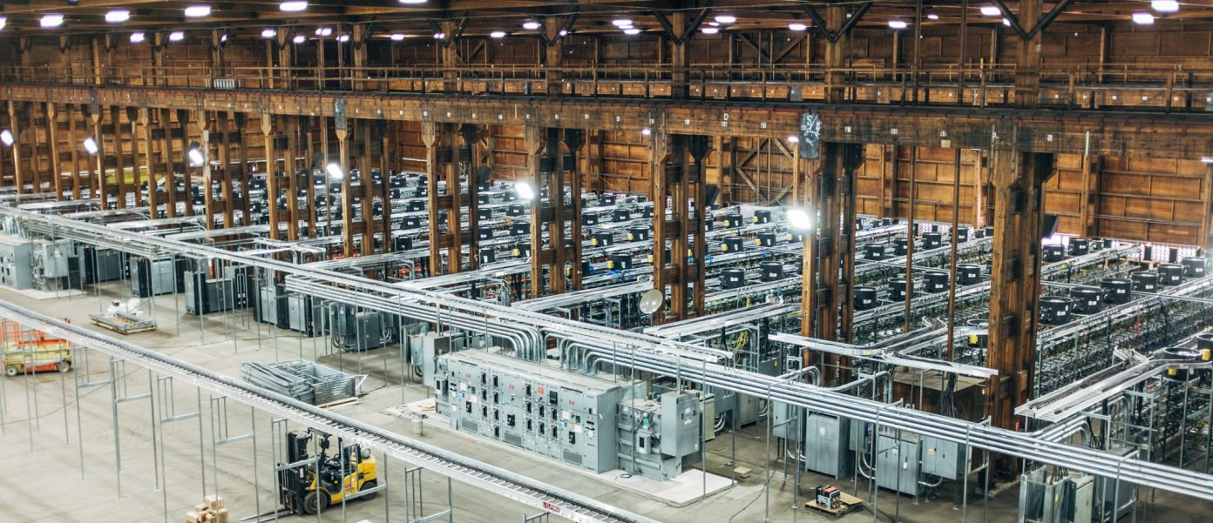

Slide 56
Rewards
Rewards
Mine by sending money

Slide 57

Move Language

Slide 58
Move
Web 4.0
More connected to financial services
Still 1.7 billion unbanked
Libra’s vision, a global and financial infrastructure that empowers billions of people
The Move language will be used to realize this vision

Slide 59
Properties
Identity
Currency
Contract

Slide 60
Sample capabilities
Resource creation
Resource modification
Resource destruction

Slide 61
Open
Open source
Open to use and build
Security risks – preventing bad actors

Slide 62
Developer Beta Mode
Until 2020
HackerOne bug bounty

Slide 63
Libra Core
First implementation of the Libra protocol and the Move language
Rust programming language

Slide 65

Incentives

Slide 66
Incentives
Seeding ecosystem
Encouraging sign ups
Possible Libra rewards

Slide 67
Know Your Customer - KYC
Wallets
KYC
Sustained activity – periodic rewards
Transaction incentive

Slide 68
% Cash Back
Wallets could give % cash back
Competition
Discounts for paying in libra
Rewards for numbers of transactions

Slide 69
In joining the Libra Association, there is an opportunity to better reach Spotify’s total addressable market, eliminate friction and enable payments in mass scale.
Alex Norström, Chief Premium Business Officer Spotify

Slide 70
Use

Slide 71
Wallet

Slide 72
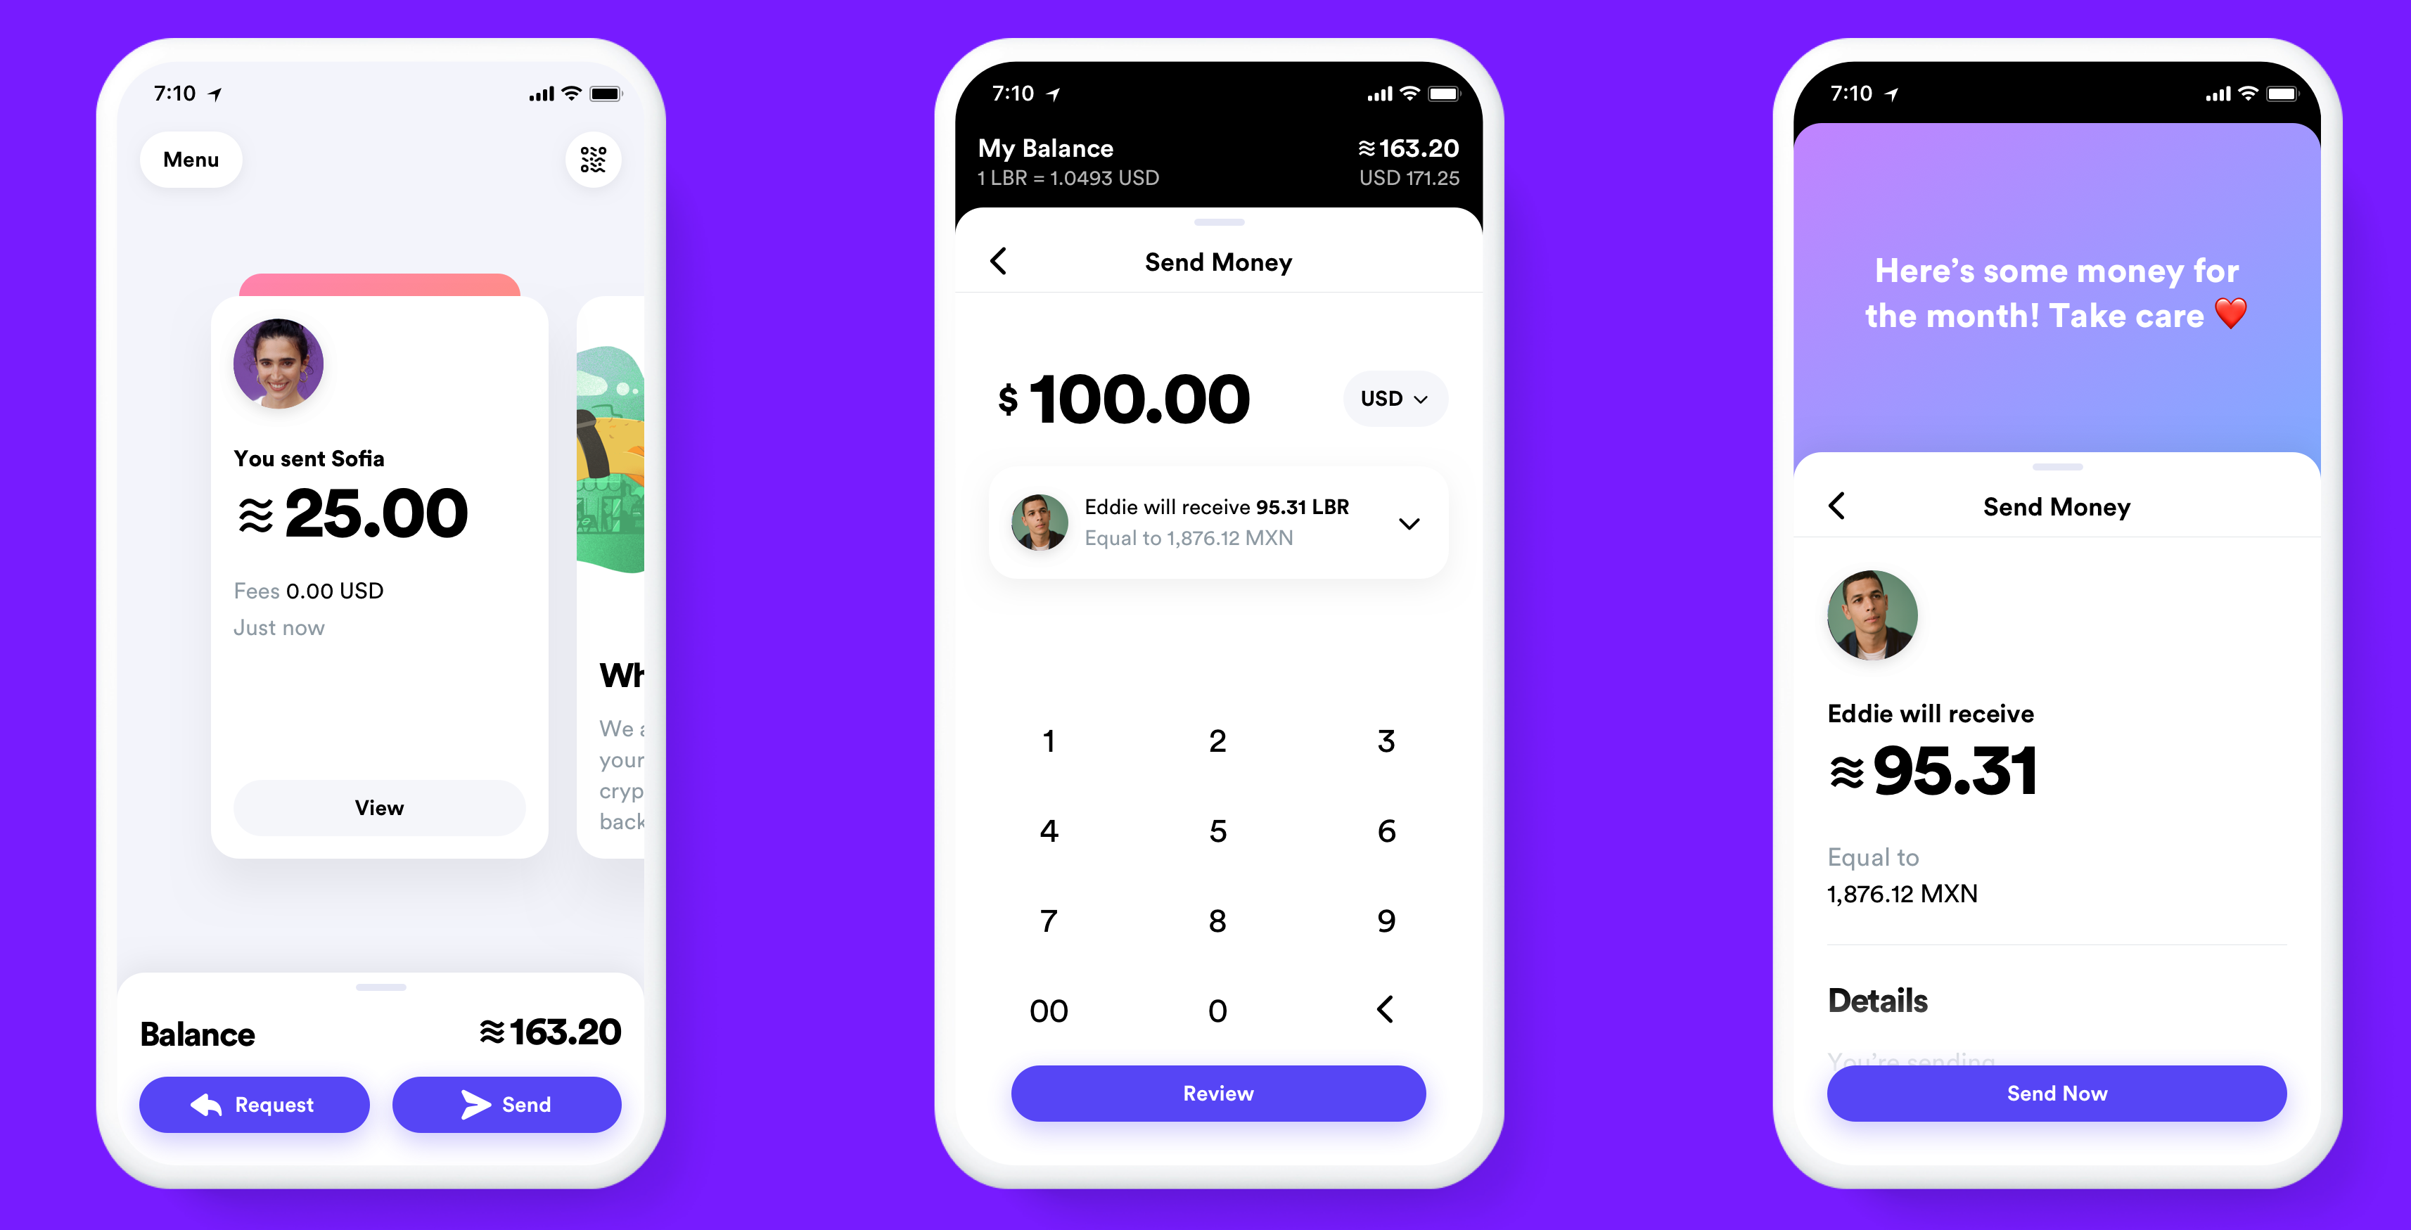

Slide 73
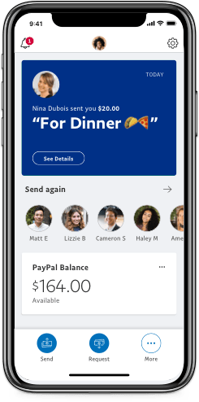

Slide 74
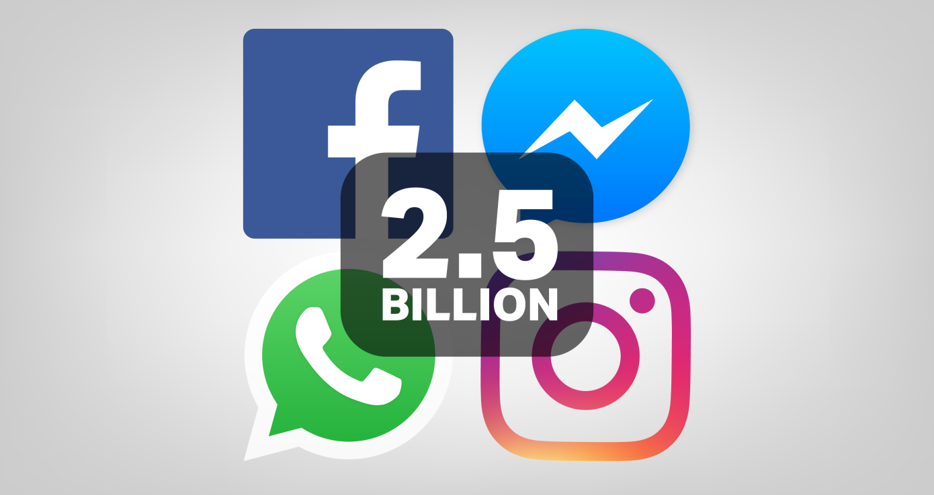

Slide 75

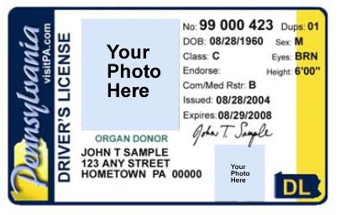
Gateway

Slide 76
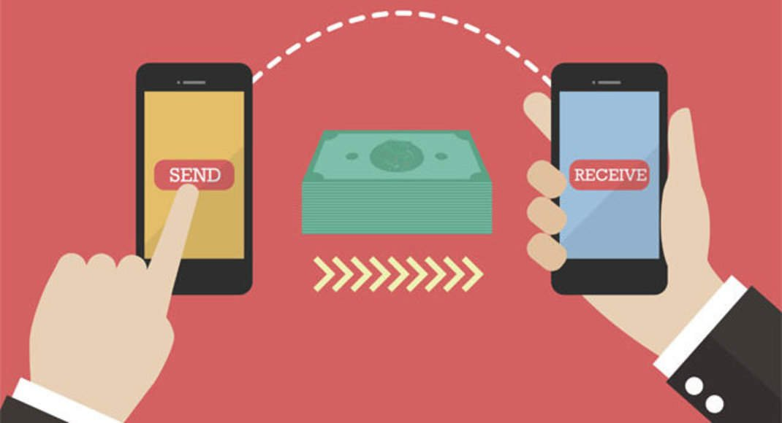
Eliminate
Traditional Fees

Slide 77
Customer support
There will be customer support
Support if you are hacked
Support if you are locked out
Calibra manages keys

Slide 78

Privacy

Slide 79
Calibra
Keeps blockchain transactions separate from FB
No ad targeting
Identity not tied to blockchain transactions

Slide 80
FB
Importing contacts is optional
Transactions data not shared with FB
Not used to:
Target adds
Rank news feed
FB account not needed to join

Slide 81
Platform is open
3rd party ethical behavior
Policing developer ecosystem can be difficult
Android ecosystem
Cambridge Analytica

Slide 82
Decentralized
Not like public blockchain
Club model (100 members)

Slide 83
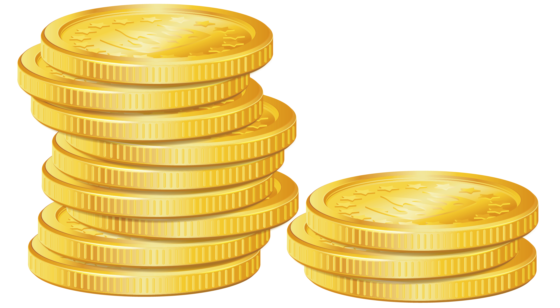
Possible Revenue
Sources

Slide 84
Interest
- It will earn a share of interest earned on the Libra Reserve of traditional currencies it holds as collateral for Libra that could mount into the billions if Libra becomes popular.

Slide 85
Ad Sales Growth
- It will see Facebook ad sales grow if merchants seek to do more commerce over the internet because they can easily and cheaply accept online payments through Libra and therefore put marketing spend into those efficiently converting channels like Facebook and Google.

Slide 86
Additional Services
- It will try to sell additional financial services through Calibra, potentially including loans and credit where it could ask users to let it integrate their Facebook data to get a better rate, potentially decreasing defaults and earning Facebook larger margins than other players.

Slide 87

Size & Scale

Slide 89

1.7 billion unbanked

Slide 91
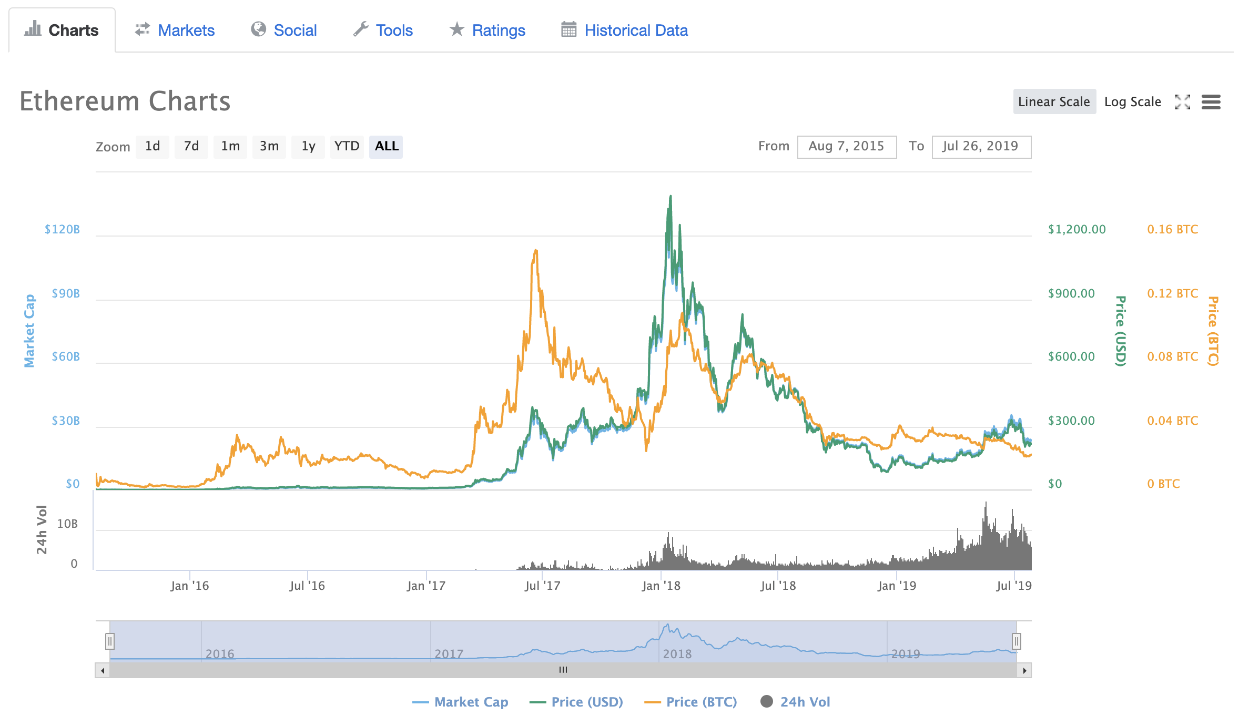
Unlike any previous ICO
Proposing a new financial platform
Ethereum
Market Cap High
$135 Billion

Slide 92
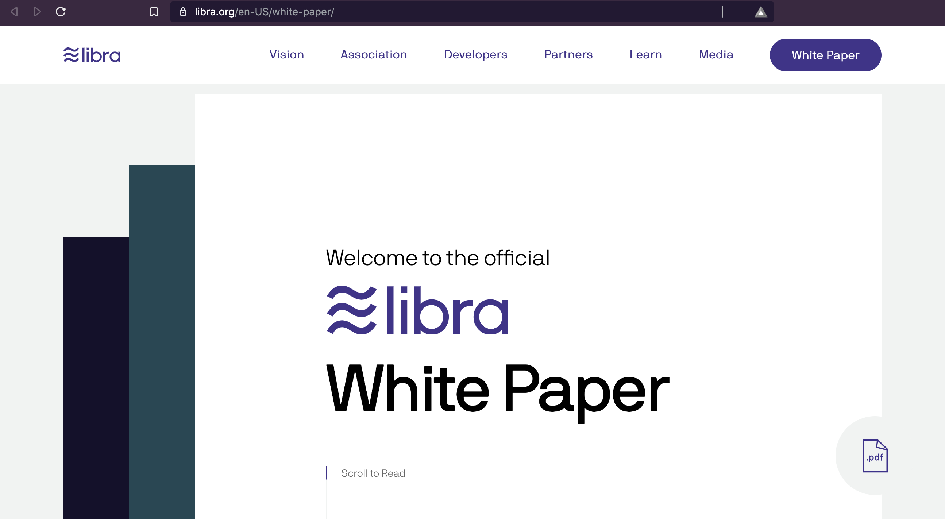
https://libra.org

Slide 93
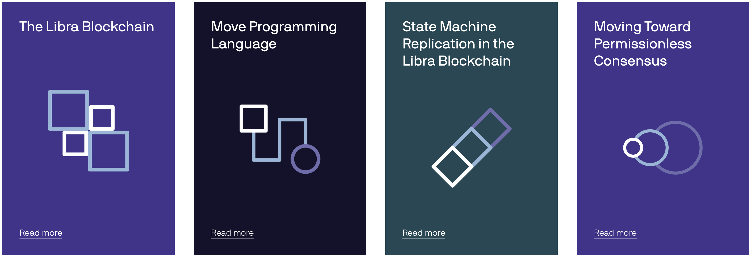
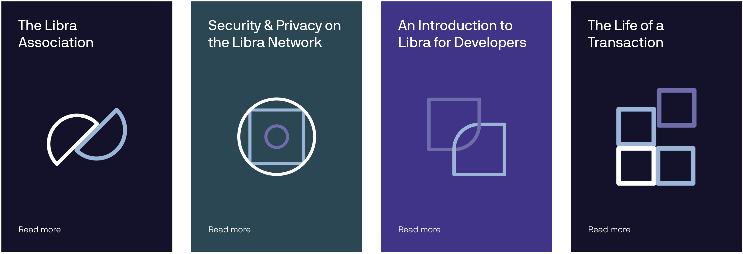

Slide 94

Concerns

Slide 95
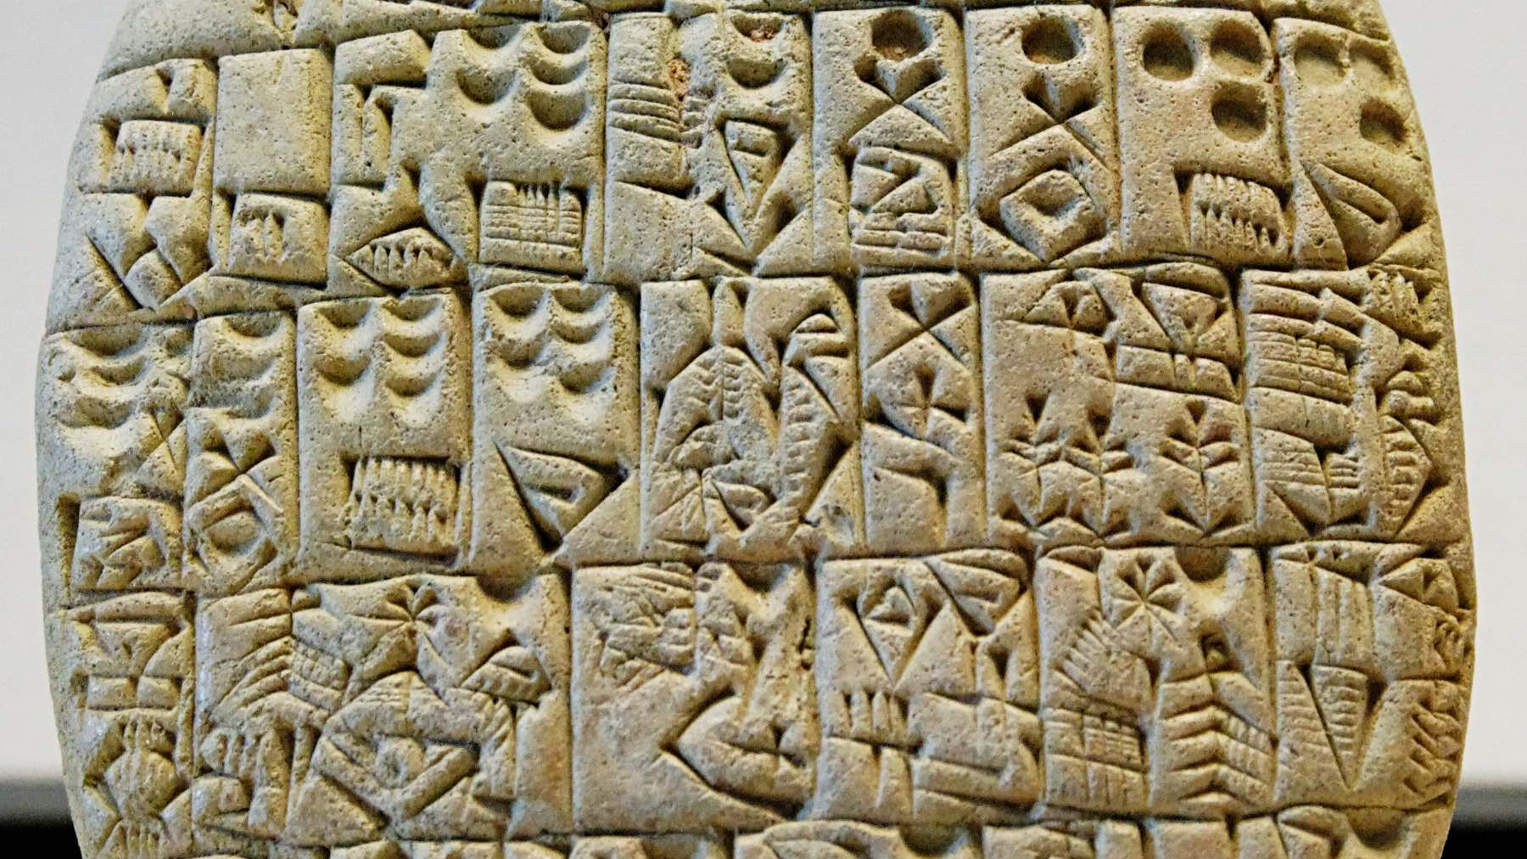

Slide 96
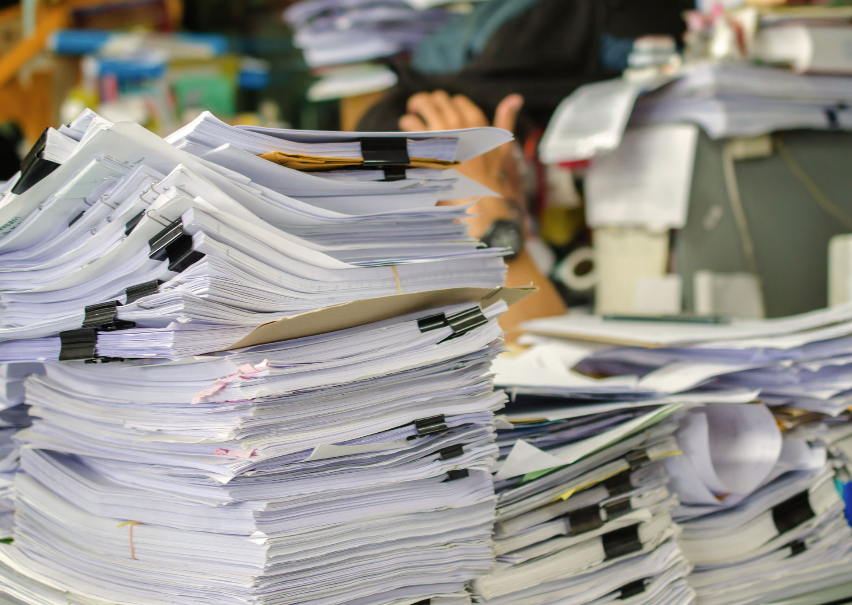
Regulation

Slide 97
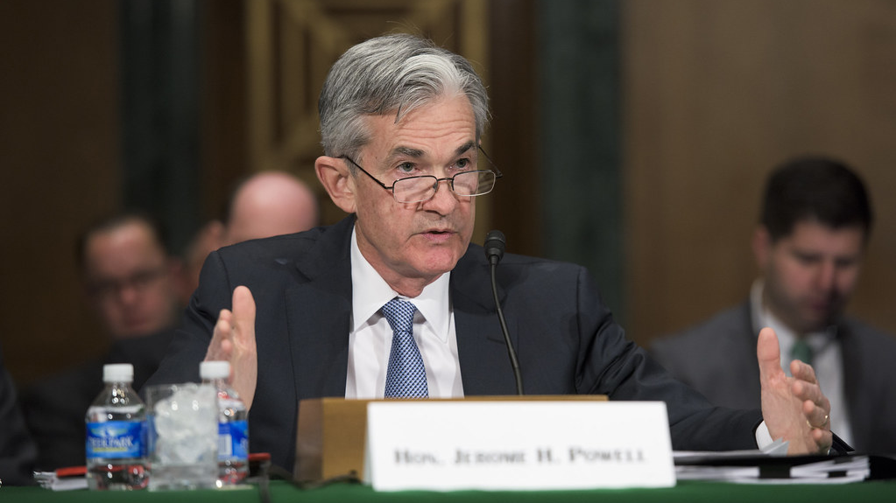
I don’t think that the project can go forward ... without there being broad satisfaction with the way the company has addressed money laundering, all of those things - Jerome Powell, chairman of the US Federal Reserve,

Slide 98
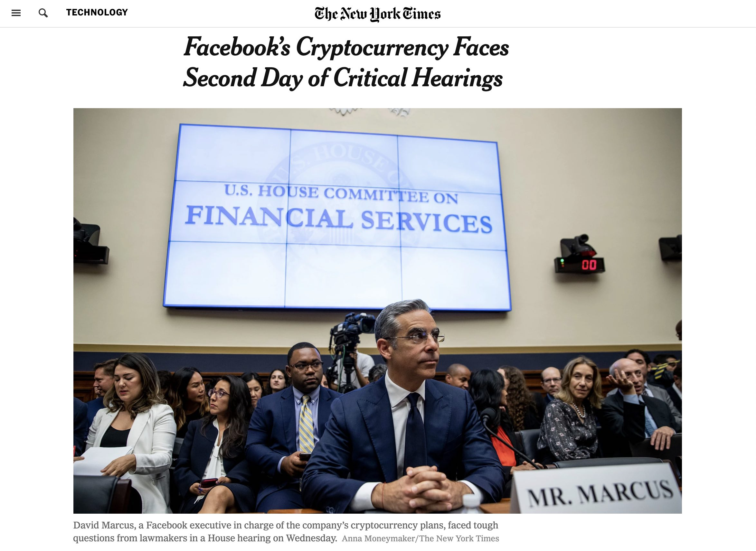

Slide 99
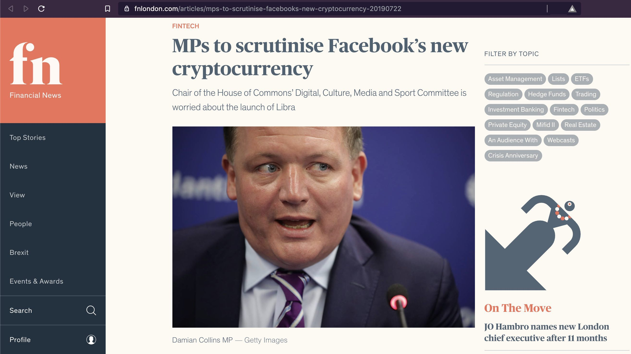

Slide 100
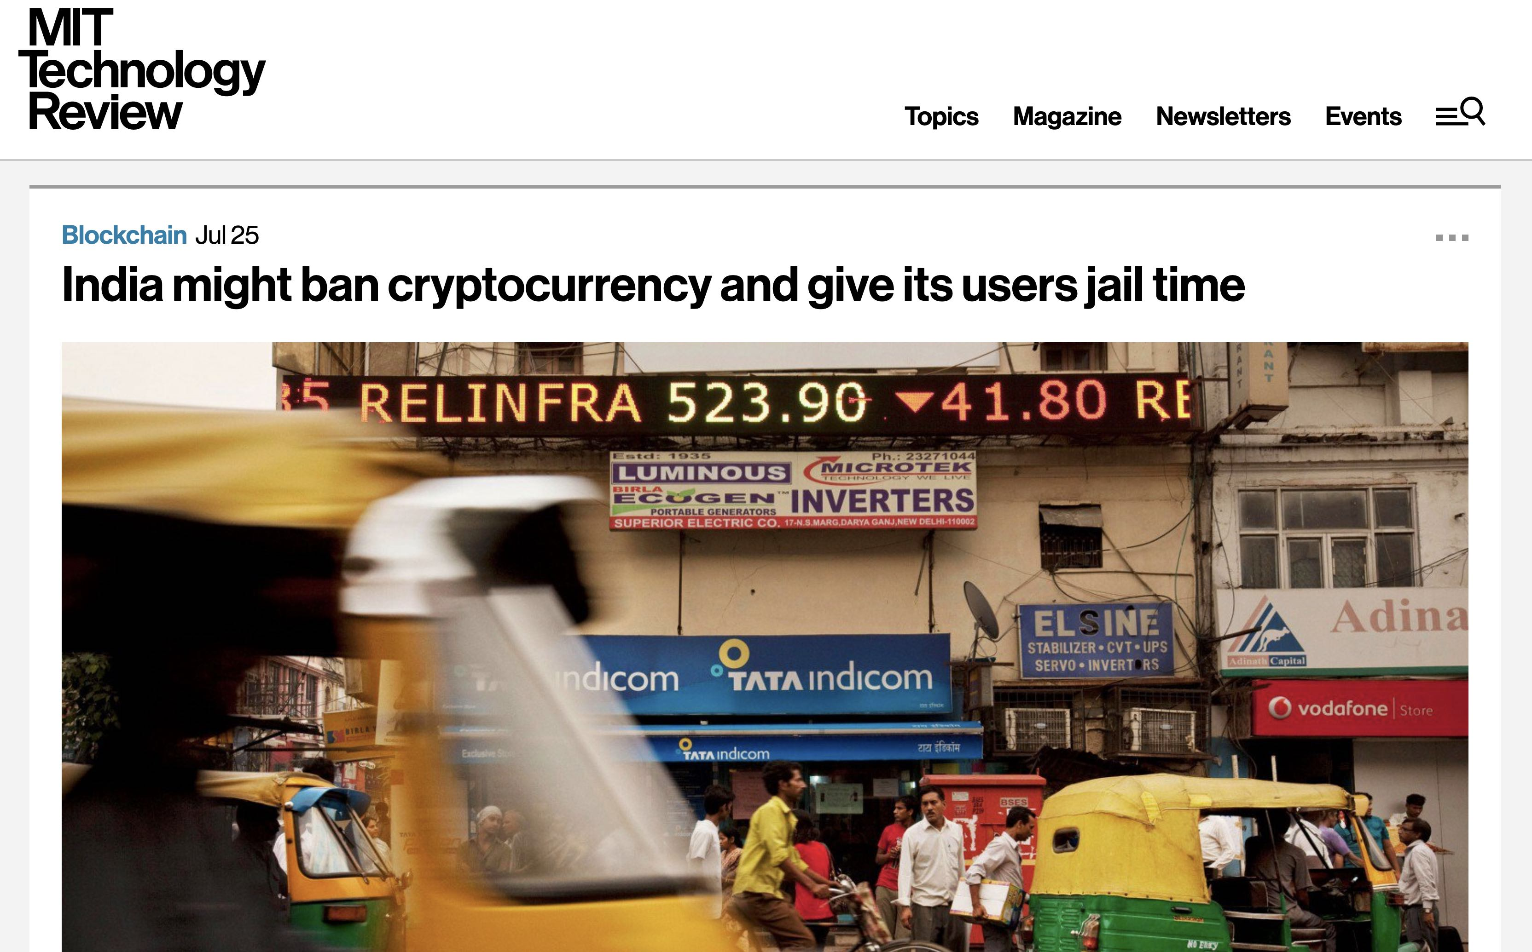

Slide 101
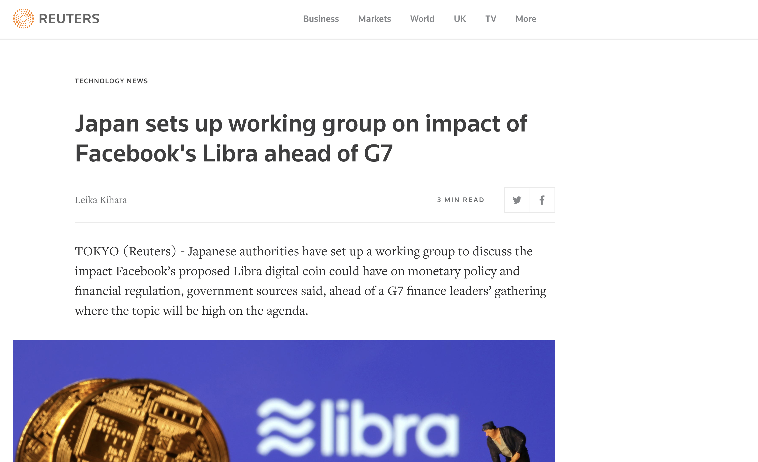

Slide 102
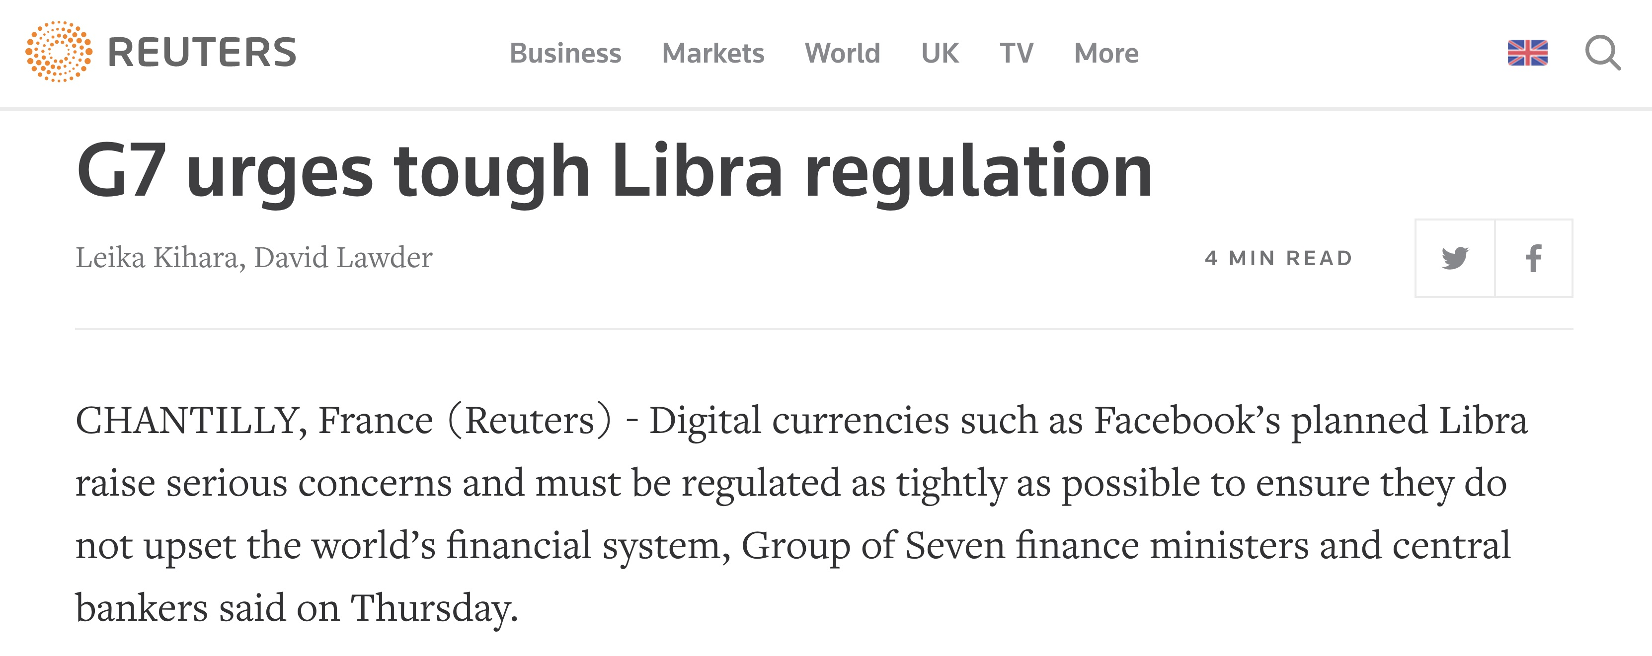
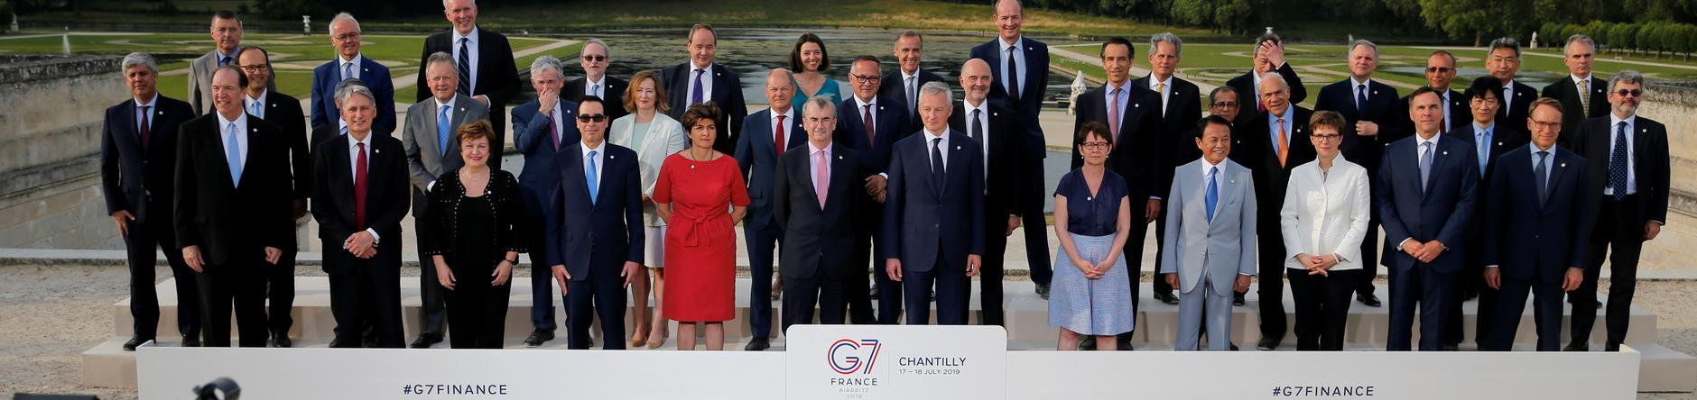

Slide 103
Concerns
National security
Less control
Investor protection
Liquidity

Slide 104
What do banks do?
Authenticate / Authorize
Confirms value
Transfer value
Store value
Lend value
Exchange value
fund & invest
Insure value and Manage risk
Account for & audit value

Slide 105
Government & Technology
Politicians are not prepared
Technologists are not prepared
Opportunity for a partnership

Slide 106
Returns

Slide 107
Libra
Libra Investment Token

Slide 108
Libra
No interest paid

Slide 109
Libra Investment token
Interest paid
Sample
$100 into libra
Assume Treasury-bill yield of 2.125 %
Association would earn $2

Slide 110
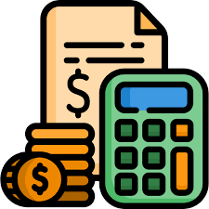


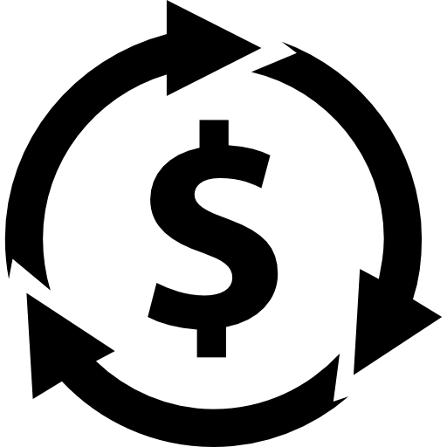
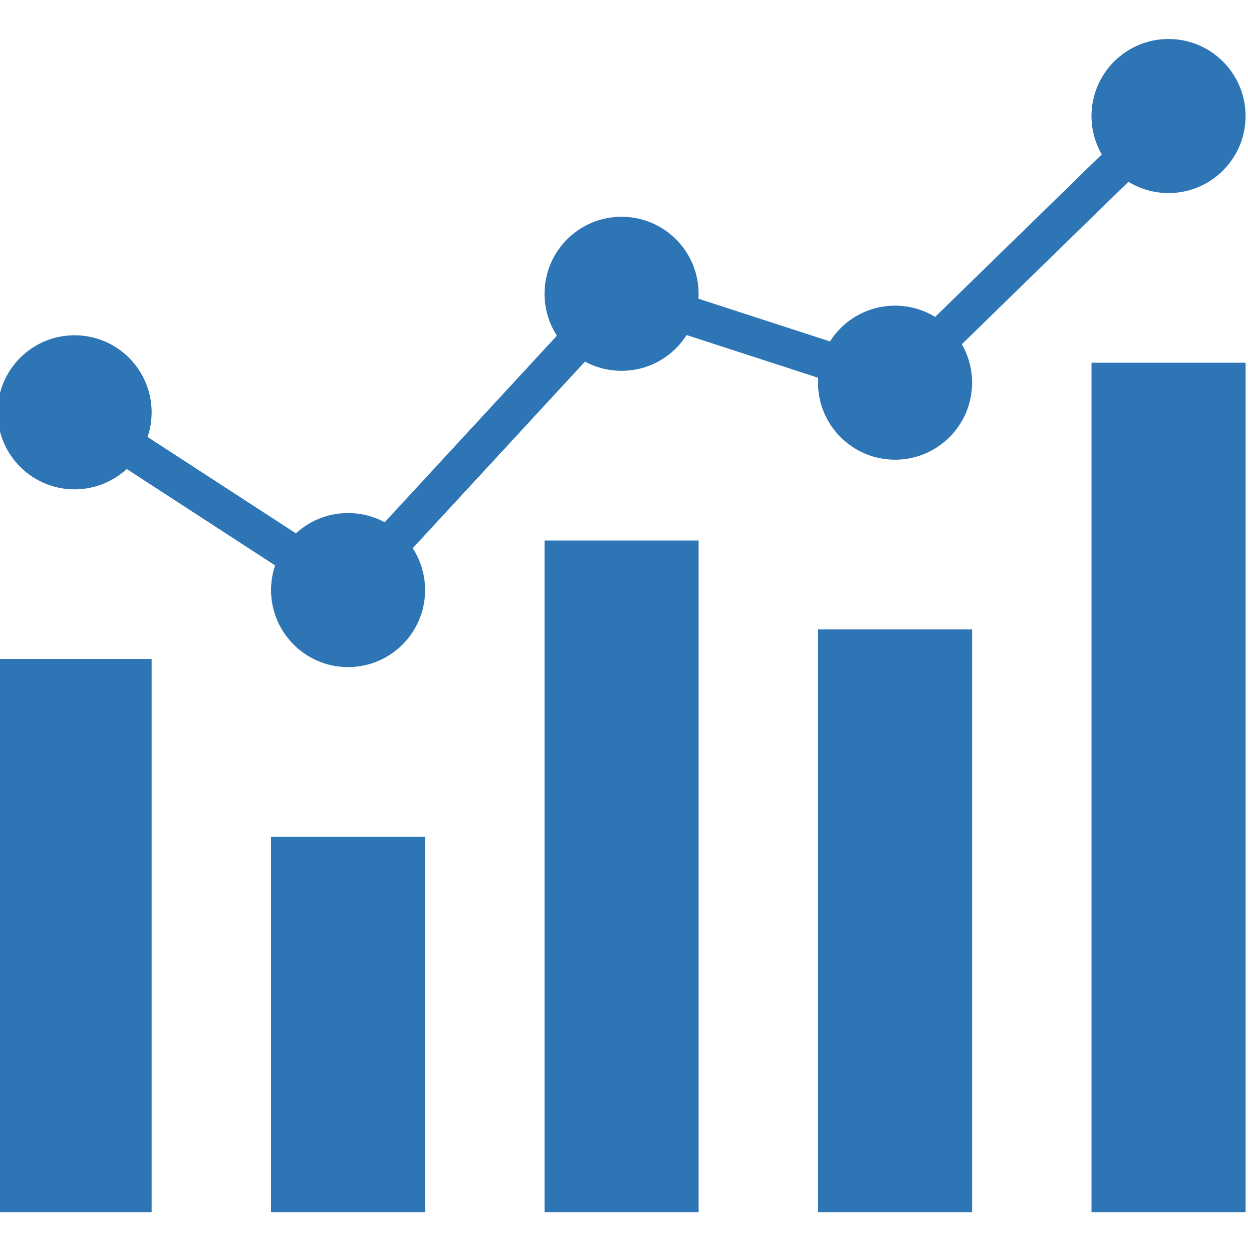
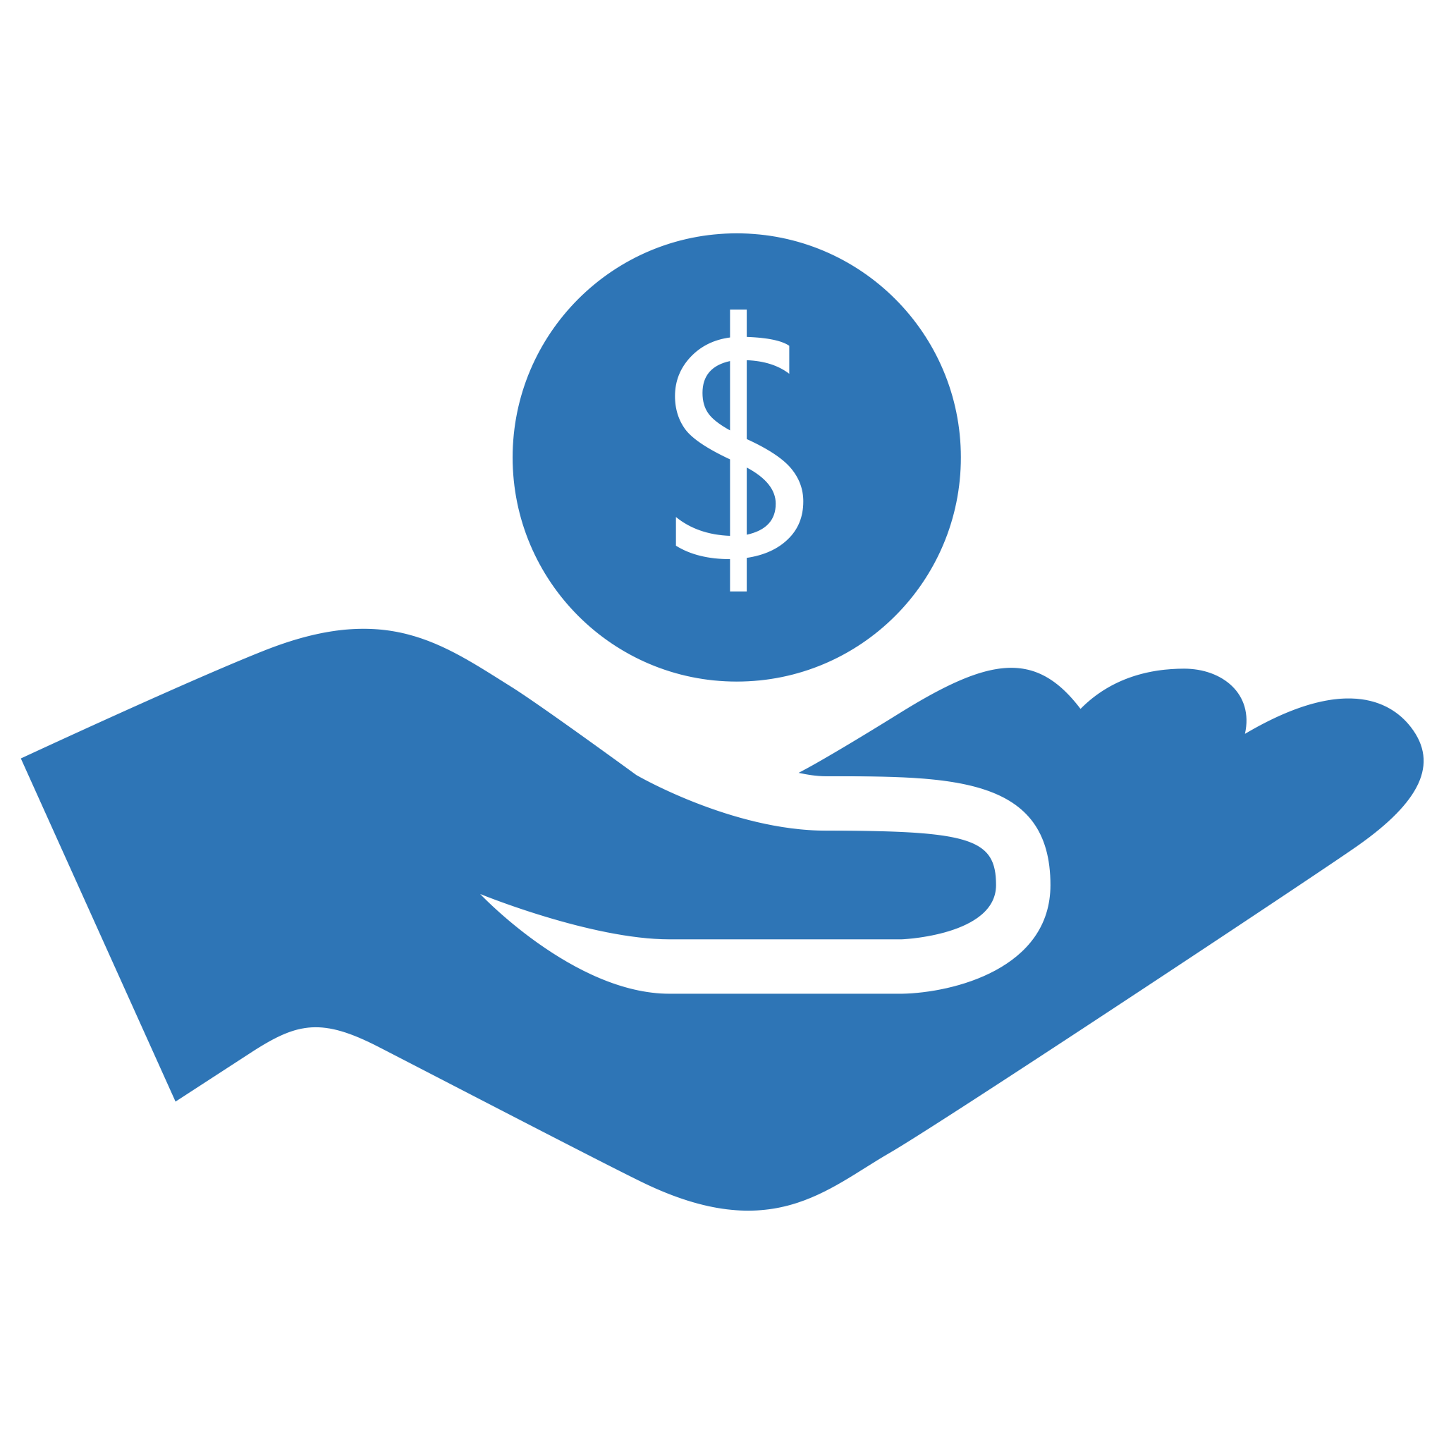
%
Operating
Expenses
Investments
Promotions
Interest
Revenue
Distributed to
Members
Research
Grants

Slide 111
Let’s consider the U.S. economy
U.S. M1
$3.7 trillion, population 329 million people
Includes: cash, coins, and money in checking accounts
U.S. M2
$14 trillion
Includes: M1 plus savings accounts, money market funds, certificates of deposit, and other bank deposits

Slide 112
Consider M1
Adoption: 10% of M1
$3.7 trillion x 10% → $370 billion
Investment tokens sales: $1 billion
Operation costs: $1 billion
Assume Treasury-bill yield holds
370 billion x 2% → $7.9 billion – 1 billion → $6.9 billion
ROI of 686%

Slide 113
$10 M investment
For one year
$10 M x 6.86 → $68.6 M
For ten years
$68.6 M x 10 → $686 M

Slide 114
Consider M2
Adoption: 15% of M2
$14 trillion x 15% → $2.2 trillion
Investment tokens sales: $1 billion
Operation costs: $1 billion
Assume Treasury-bill yield holds
$2.2 trillion x 2% → $46 billion – 1 billion → $45 billion
ROI of 4,500%

Slide 115
$10 M investment
For one year
$10 M x 45 → $450 M
For ten years
$450 M x 10 → $4.5 B

Slide 116
Consider 25% of M2 for Global Adoption
Adoption: 25% of M2
$14 trillion x 25% → $3.6 trillion
Investment tokens sales: $1 billion
Operation costs: $1 billion
Assume Treasury-bill yield holds
$3.6 trillion x 2% → $76.5 billion – 1 billion → $75.5 billion
ROI of 7,550%
Bigger than the Commercial Bank of China (ICBC)
It took ICBC 35 years to reach global dominance

Slide 117
$10 M investment
For one year
$10 M x 76 → $760 M
For ten years
$760 M x 10 → $7.6 B

Slide 118
Derivatives
Opportunity for “trustless,” tokenized, collateralized assets and derivatives marketplace
Derivative, collateralized markets could represent trillions of dollars of additional capital to the Libra system.

